Slide 1
OptiMark – Optimised Multi-Objective Biomarker Selection
USER NOTE:
There are more Title Slide options available to add to your presentation by going to:
Home tab > New Slide > Drop down arrow
From reproducible signatures to translational-ready panels
Presented by Wenze Ding

Slide 2

Talk Overview
Motivation: clinical translation demands more than high AUC on a single cohort
Key gaps: transferability, patent, shadow contribution of non-selected markers
What OptiMark does: explicit objectives and constraints → a clinically feasible solution set
Contributions: a framework, scalability, applications

Slide 3

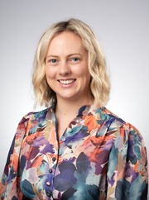
Problem motivation
Translational Obstetrics Group
from Melbourne Medical School
Use blood analytes to predict
Fetal Growth Restriction (FGR)
Postdoctoral Research
Fellow
Lucy Bartho

Slide 4
Brief backgrounds of FGR
Pregnancy is a complicated process with maternal, placental and fetal factors determine pregnancy outcomes.
Fetal growth restriction (FGR) affects ~5% of pregnancies.
FGR increases risk of stillbirth, neonatal complications, and long-term disease.
Better biomarkers could guide timely interventions and reduce preventable harm.

Slide 5
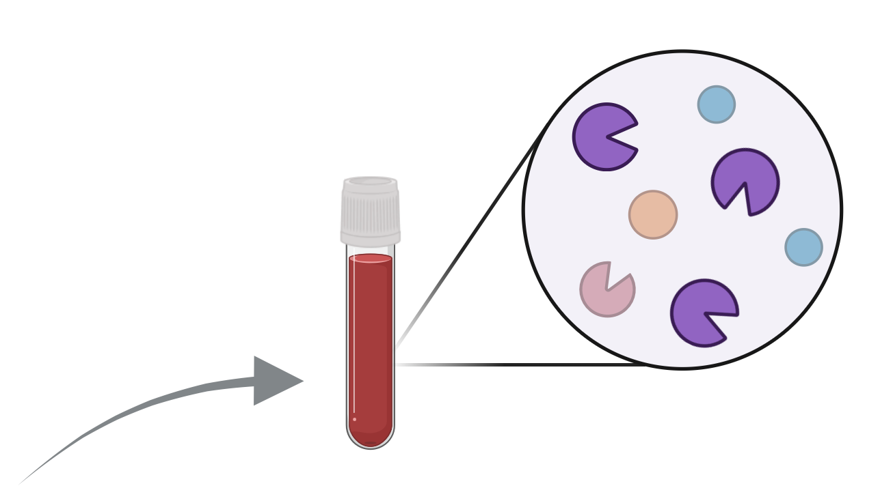
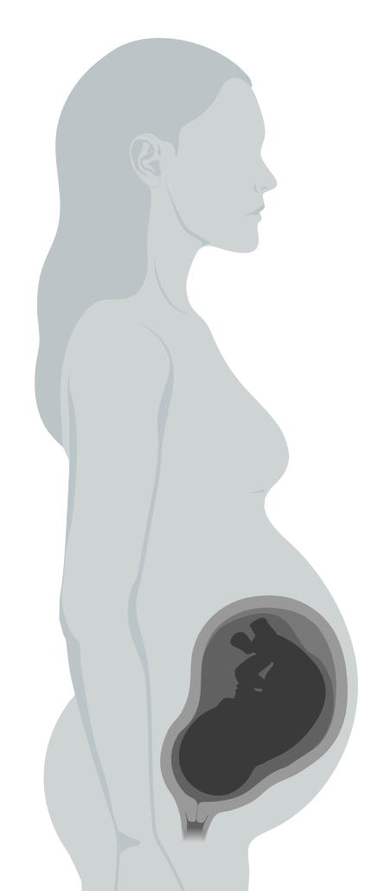
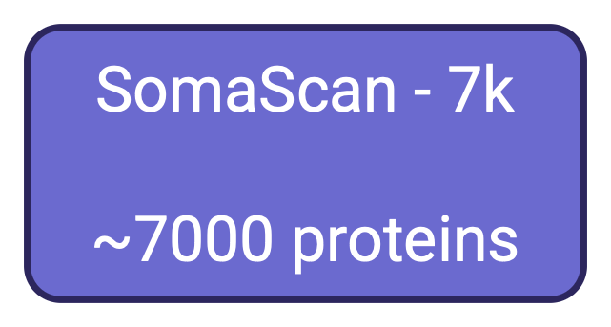


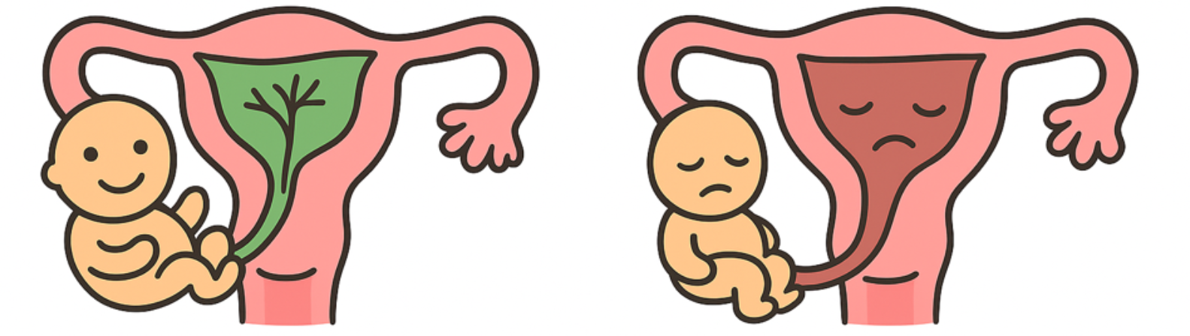
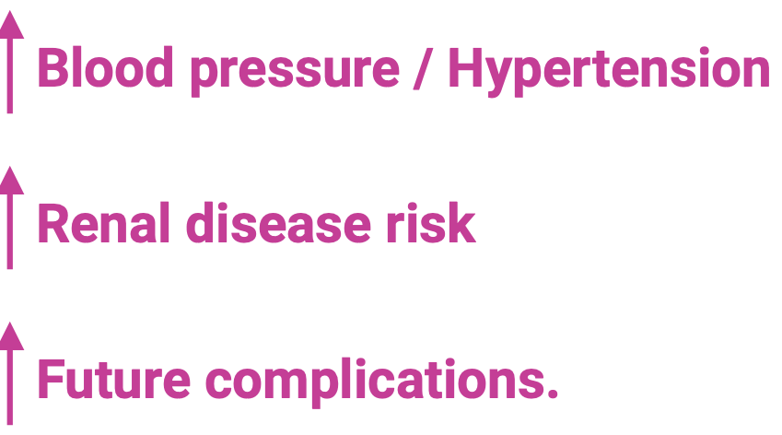
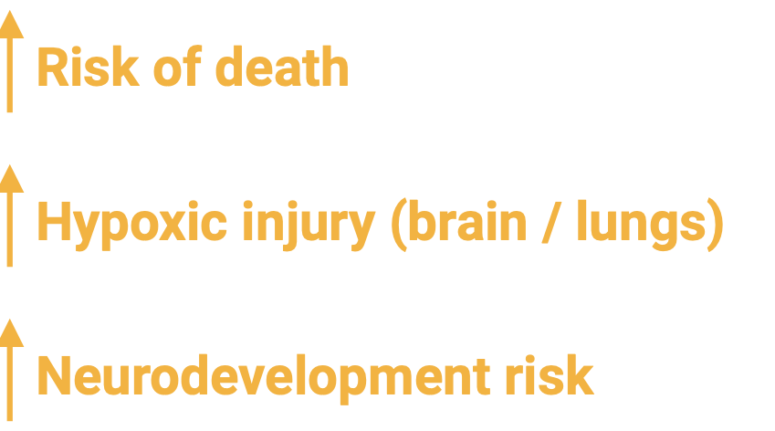

Slide 6
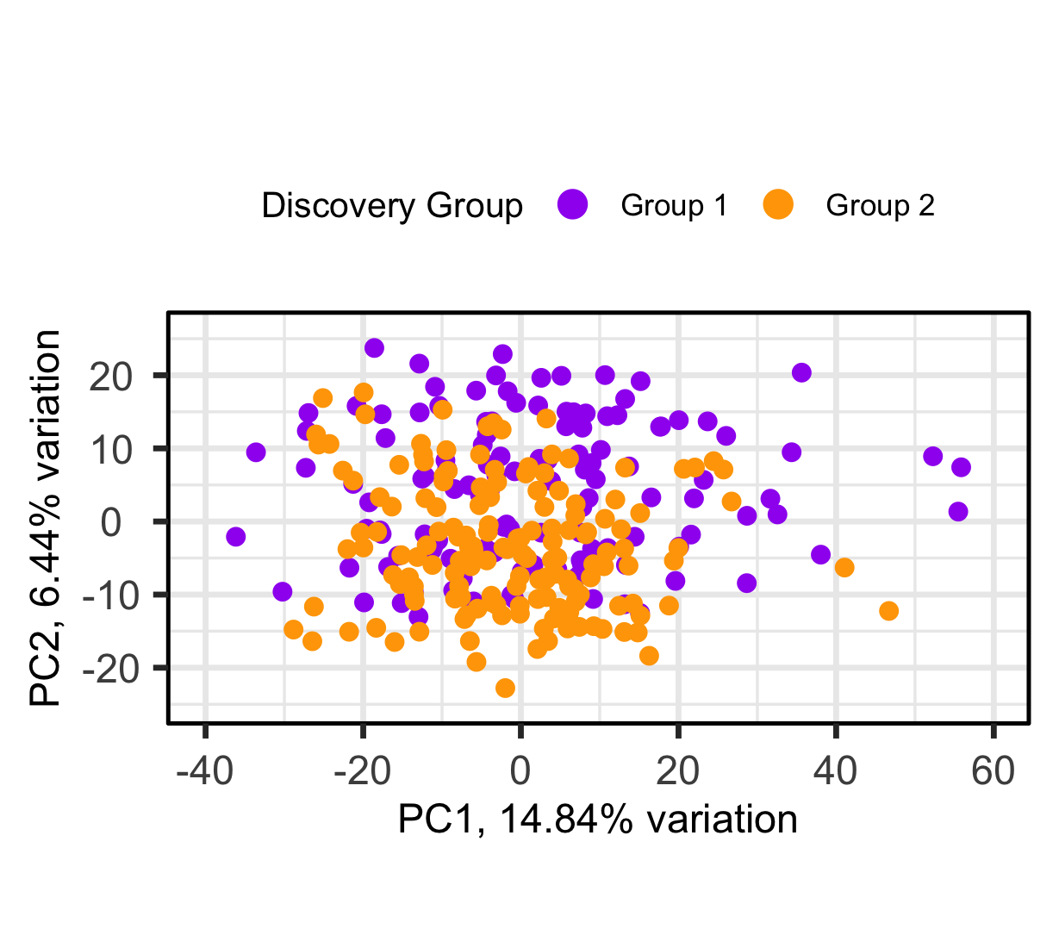
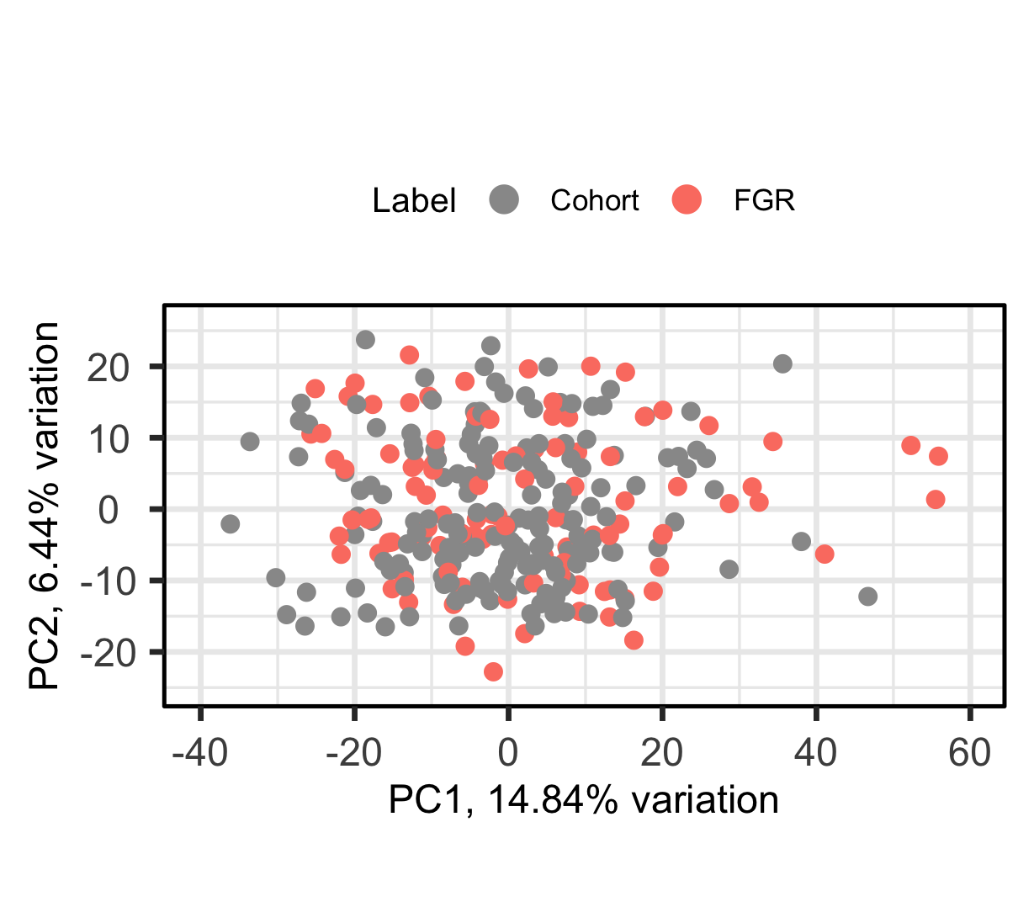
We have 2 Cohorts
Collaborator’s data arrived in two batches (1 & 2).
No biological reason for which cohort a sample was assigned to.
Cohort 1 (n = 126), Cohort 2
(n = 156).
Our goal is to use cohort 1 as discovery and cohort 2 as validation.
Too much （ask jie for help）

Slide 7
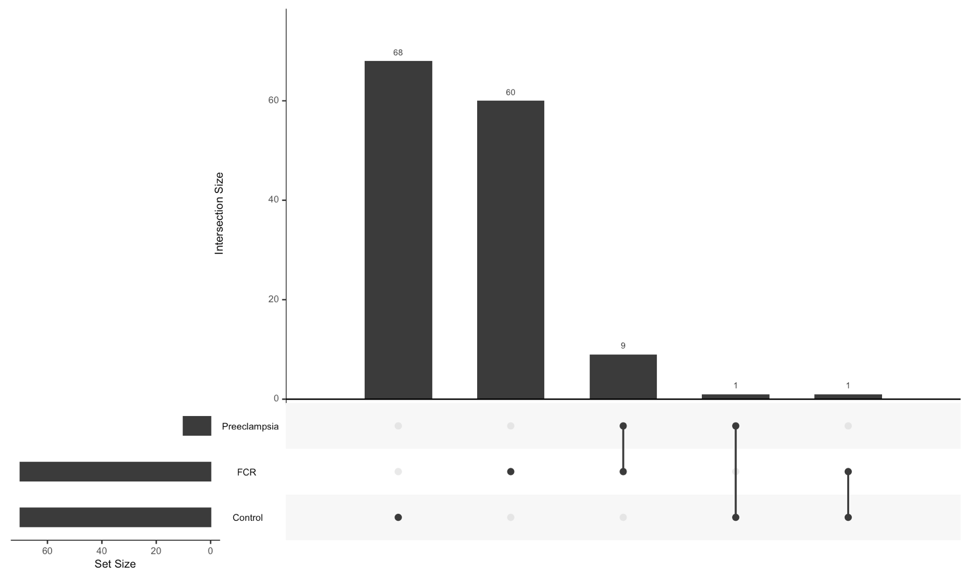
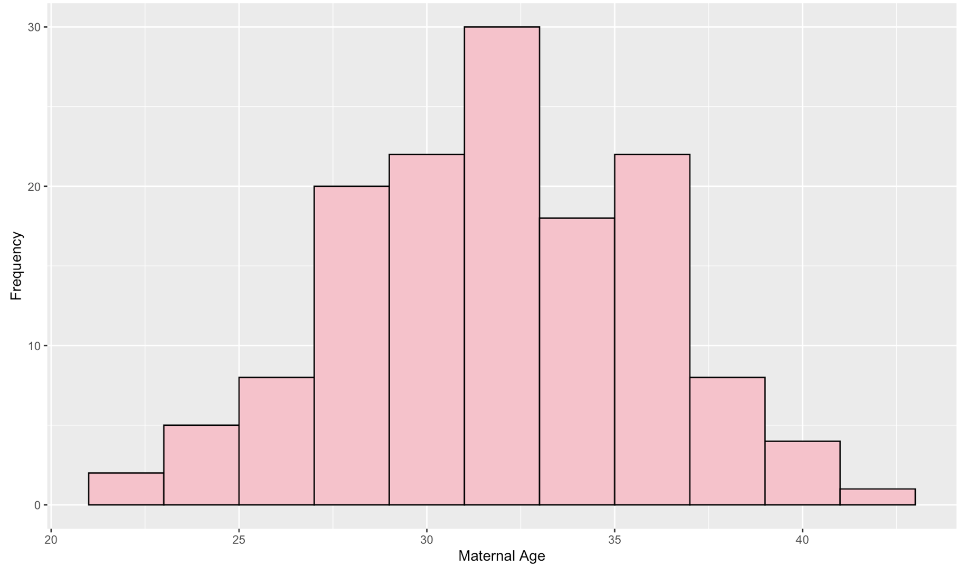
A sense of Metadata
6 and 7 come together （ask jie for help）

Slide 8
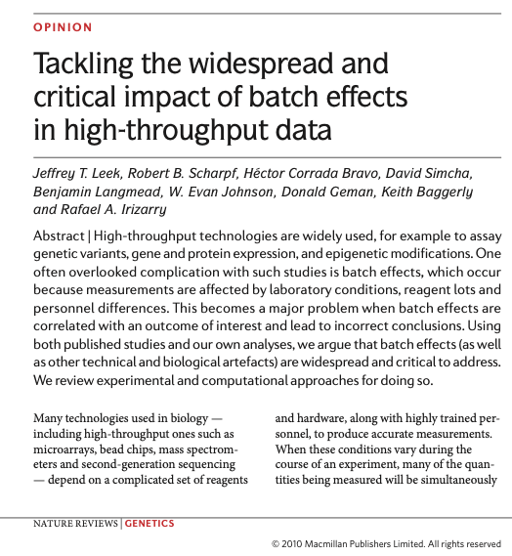
What is special in this biomarker discovery project ?
Since the early 2000s, there are probably >150,000 biomarker discovery papers
Yet translation is strikingly slow, we are struggling to get from bench-to-bedside, only on the order of ~100 looked clinically useful.
A little while ago, people think the issue is reproducibility – but that didn't quite fix the problem

Slide 9
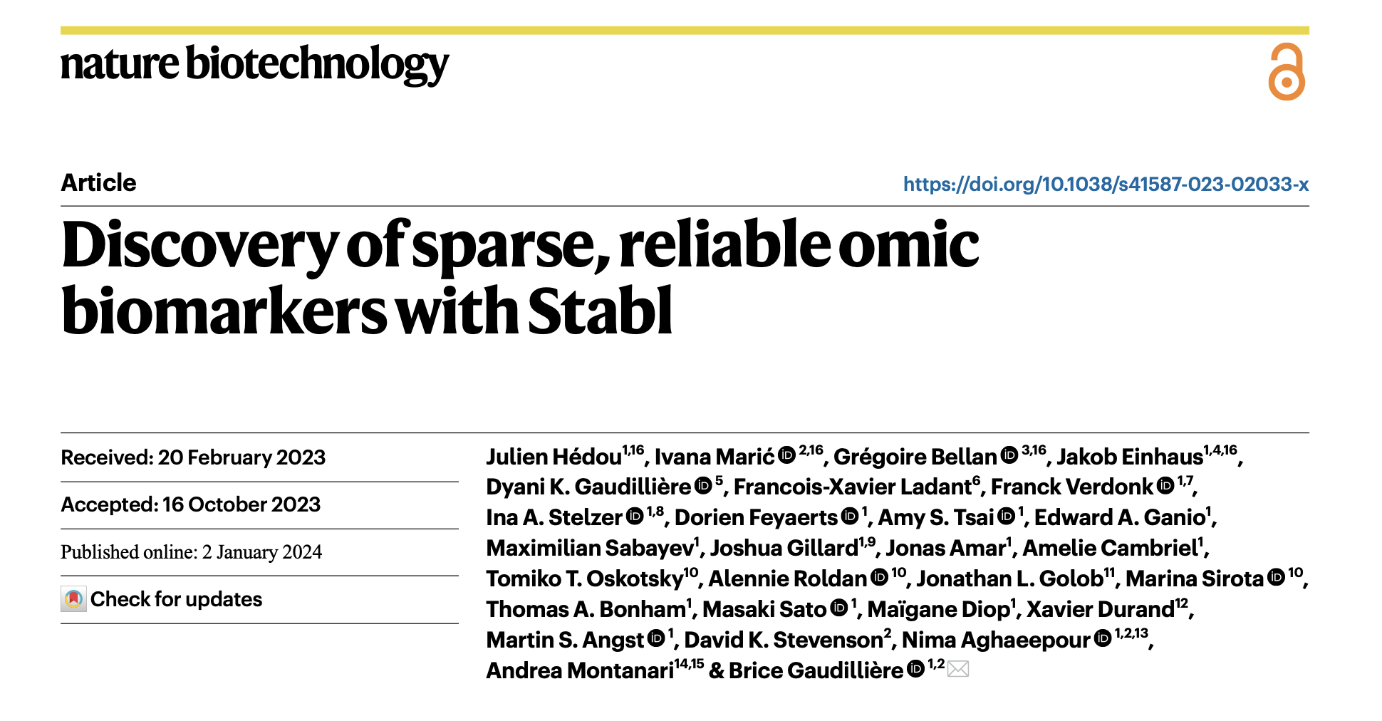

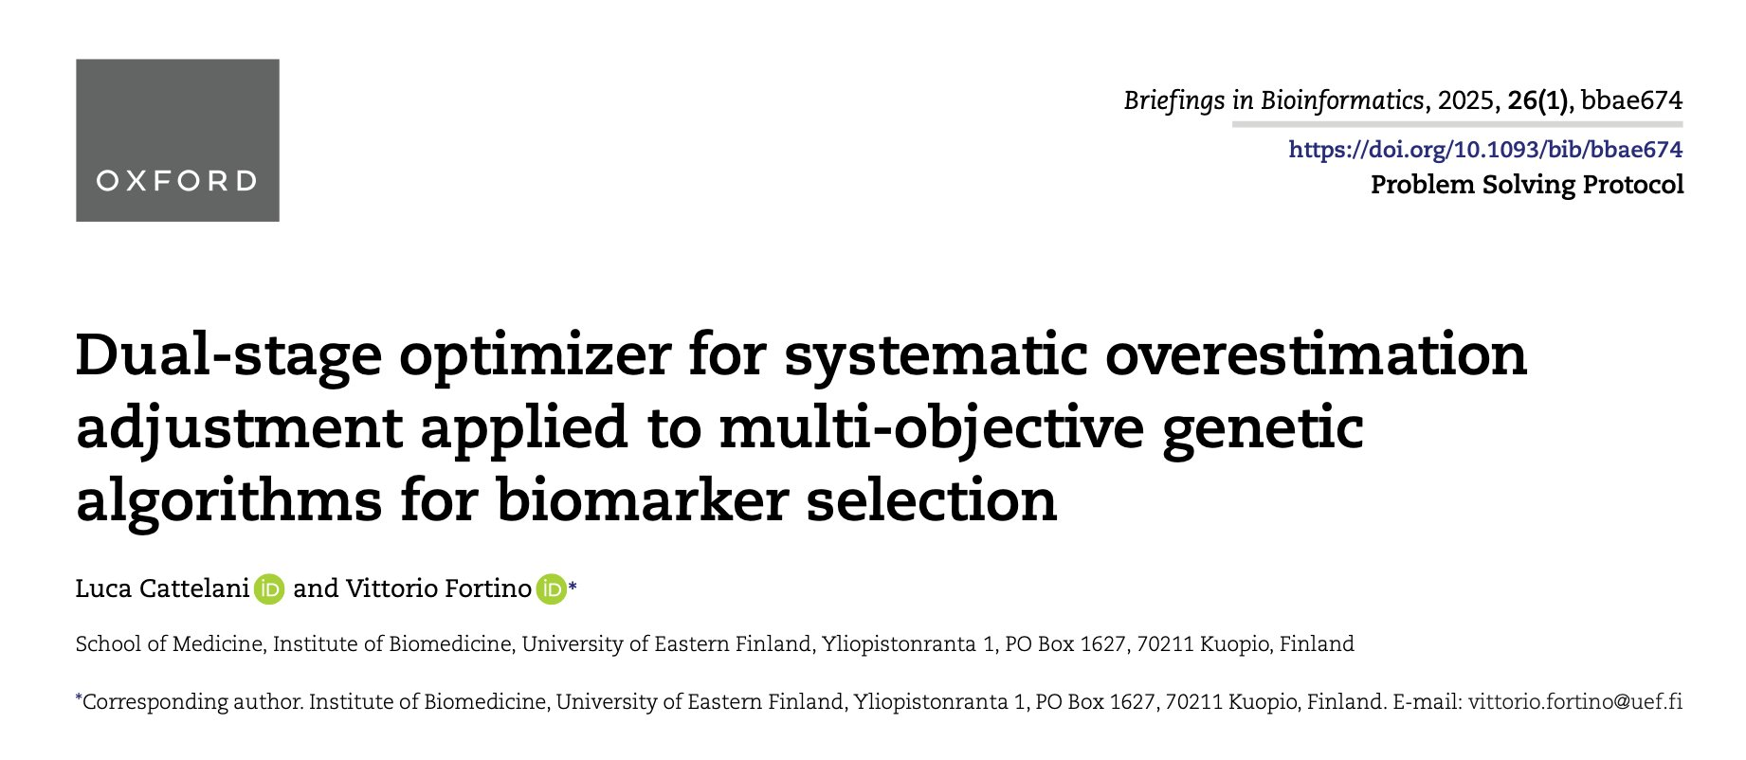

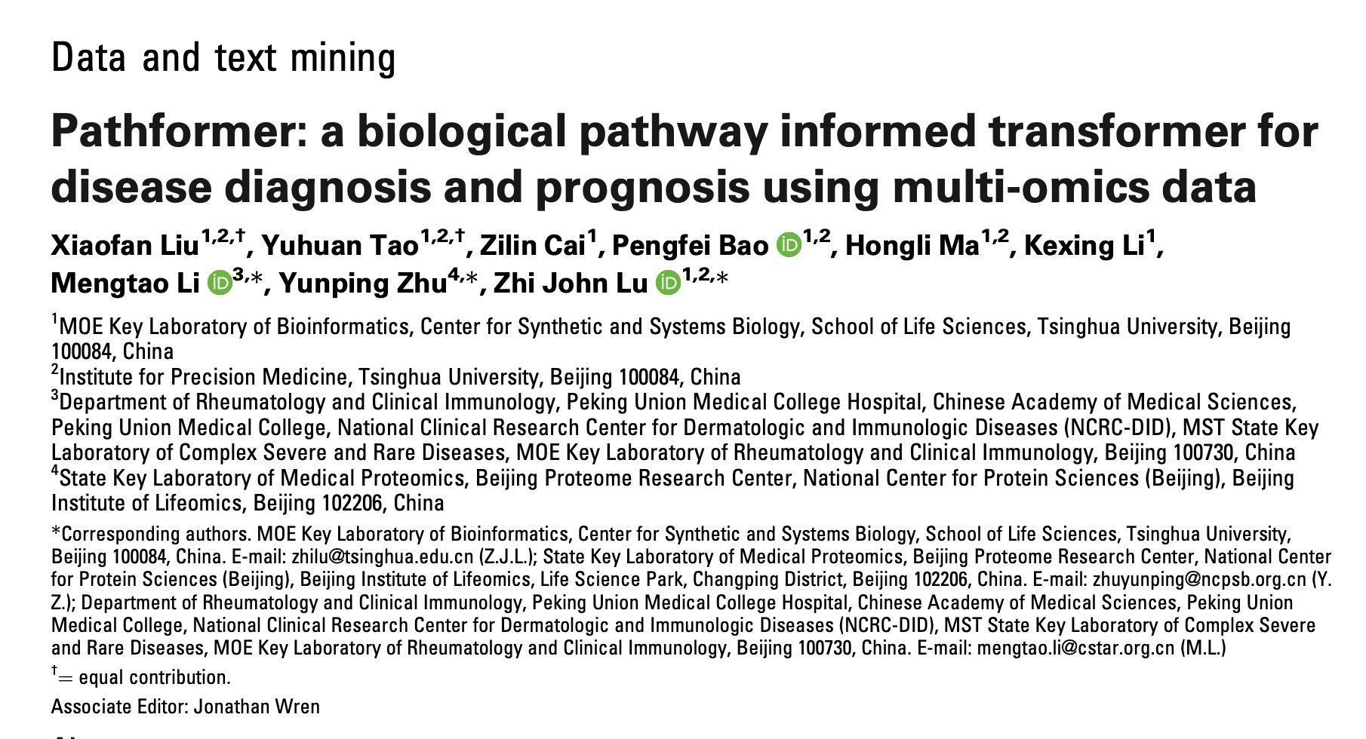
What has been being addressed and what has not?
Reproducibility & batch effects
Assay migration: discovery (thousands)
≠ implementation (less than 5)
Misaligned evaluation targets:
AUC/F1->sensitivity@specificity
Transferability & risk of bias
Patents

Slide 10
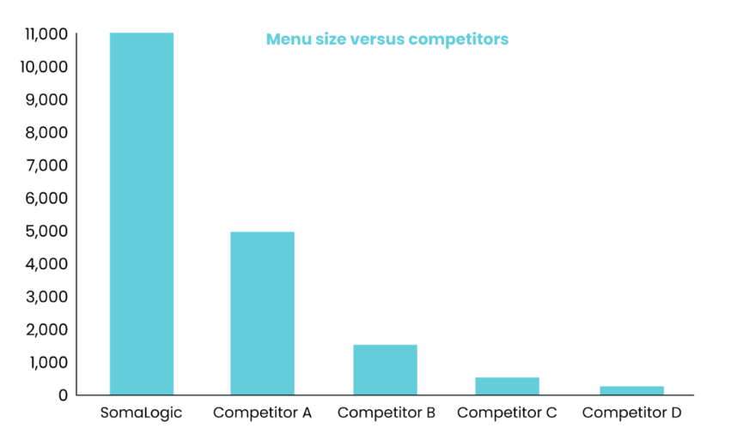
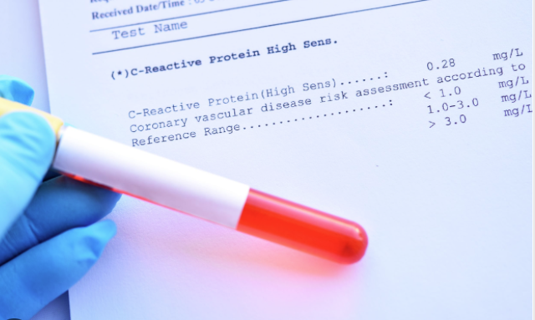
Assay migration→ small panel
Discovery research (from SomaScan webpage)
Clinical implementation (Generally 1-5 biomakers)

Slide 11
Problems--> MOO
Needs of Small
Patents
What makes features patentable?
Issues in biomarker discovery
You tell people how it works; in return you exclude others from using it.
Novelty – Biomarkers need to have not been disclosed in exact combination before.
Non-obvious – “Someone skilled in the art” could not come to this conclusion. (stops meta-analysis)
Reproducible - “Someone skilled in the art” should be able to verify your claims. (stops overreach)
1. When trying to patent a set of genes. You need to smallest number (2-5).
2. If I have a 5 gene panel, but someone uses 4 of those, that is ok.
3. However, we know that there is a lot of collinearity in expression data.
(CXCL9 exprs = CXCL10 exprs)

Slide 12
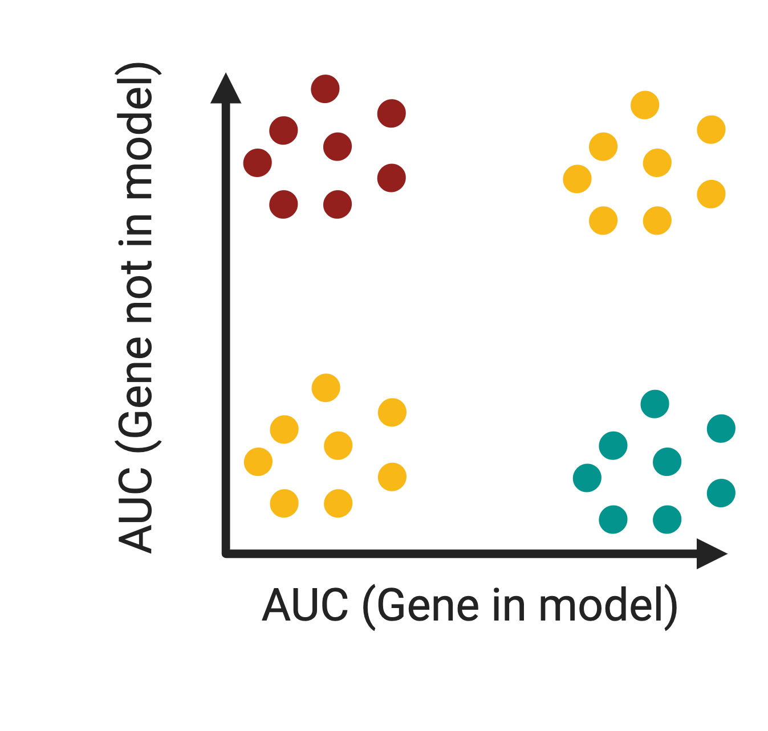
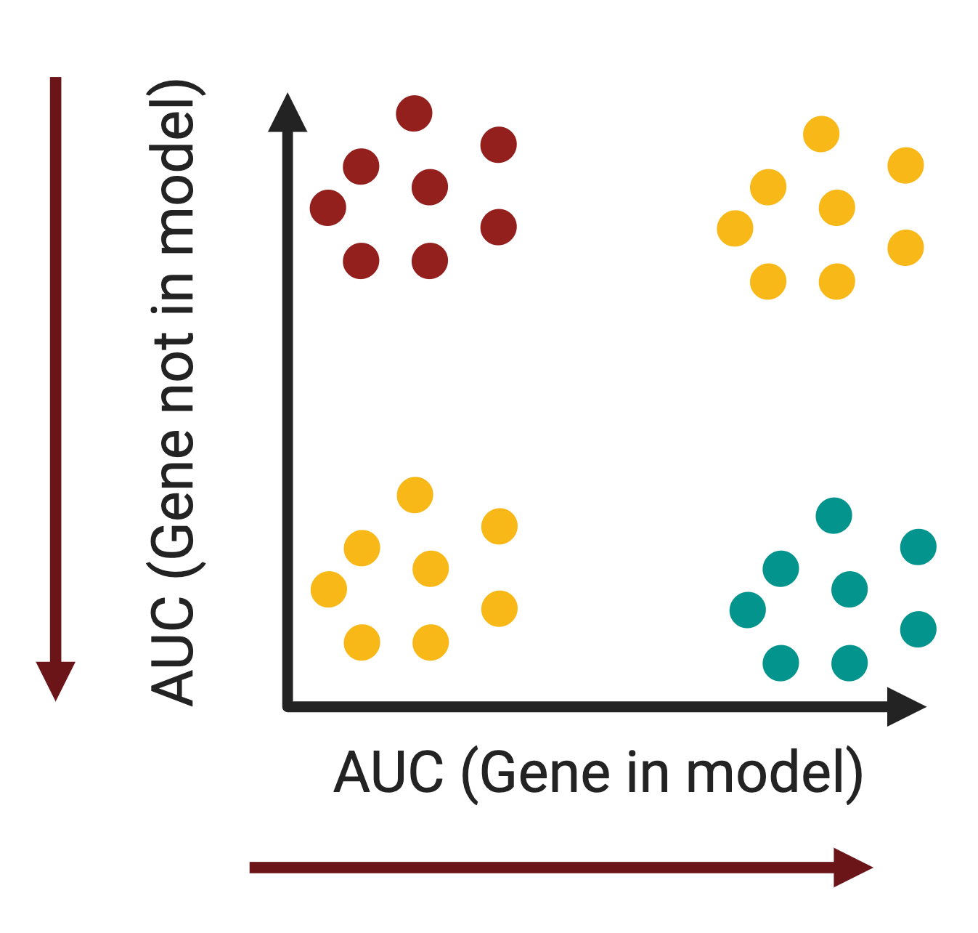
Why different metrics is needed
Patents
So what can we do?
Current statistical approaches explore what genes are most important to diagnose a condition.
But really, we want to know what genes are critical for model building.
I.e. what gene X is needed to build good models. But if absent, no model can be built.

Slide 13
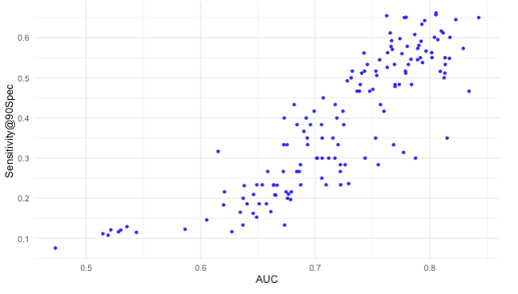
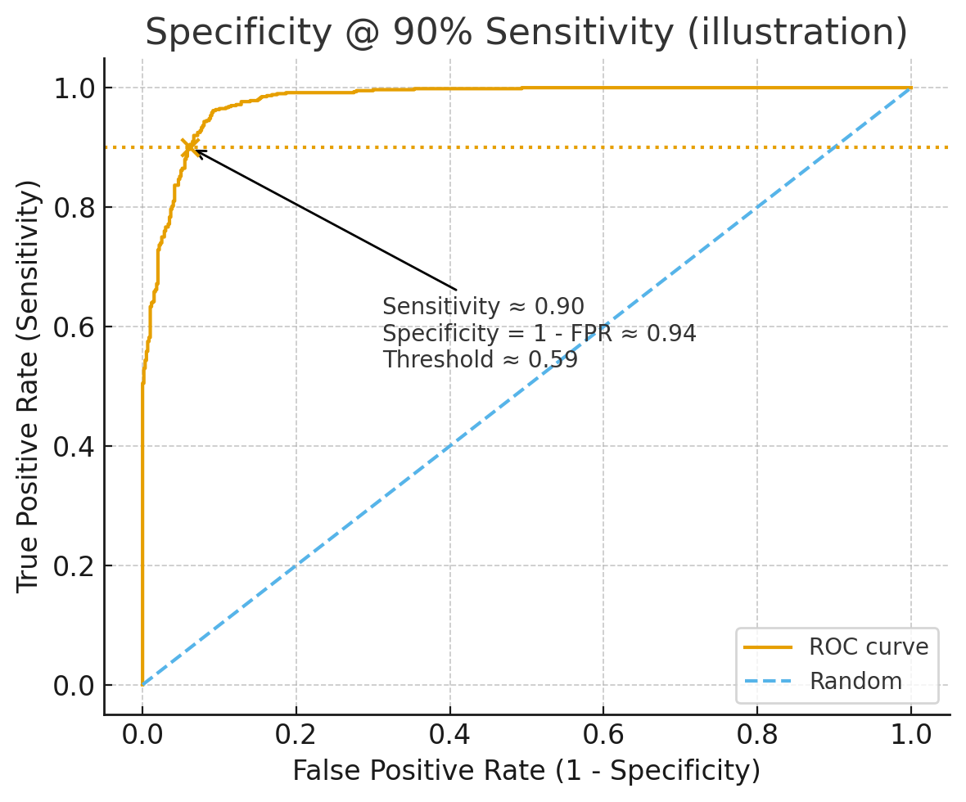
Misaligned evaluation Different language – better translation between disciplines
Clinical focus: Sensitivity @ 90% Specificity
AUC and Sensetivity@Specifity is not always aligned

Slide 14
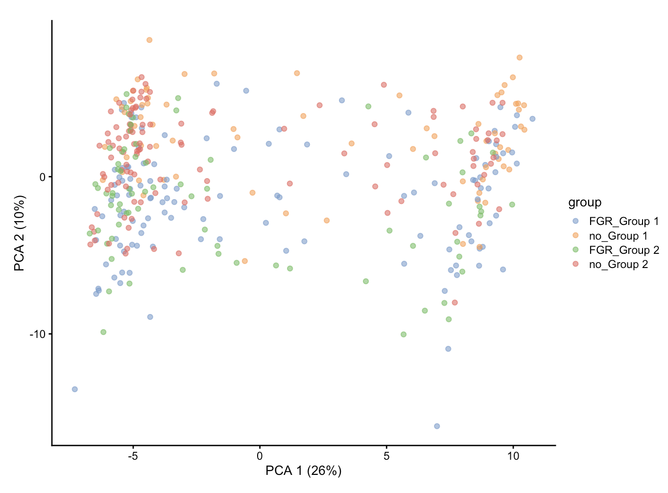
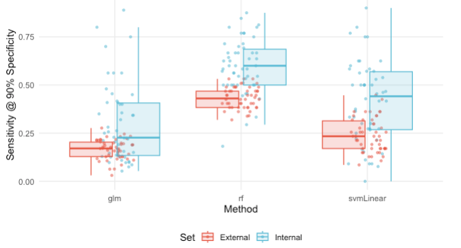
Transferability
Two cohorts have distribution shift
Traditional machine learning feature selection methods does not work

Slide 15
Brief summary: From Omics to Clinic
High-resolution molecular profiles (transcriptome, proteome, metabolome) enable precision medicine
Clinical reality: adoption requires robustness, reproducibility, low redundancy, assay feasibility and compliance
Transferability across cohorts/platforms is critical for real-world utility
Take-home: Clinical adoption requires transferability and assay feasibility, not just high internal AUC.

Slide 16
Gap & Problem Statement
Combine 16-17
Transferability seldom an explicit optimisation objective
Patentability/cost/operational constraints often ignored
Non-selected features’ predictive influence (shadow effect) is overlooked
Lack of log-ratio/zero-sum stabilization against platform/batch effects

Slide 17
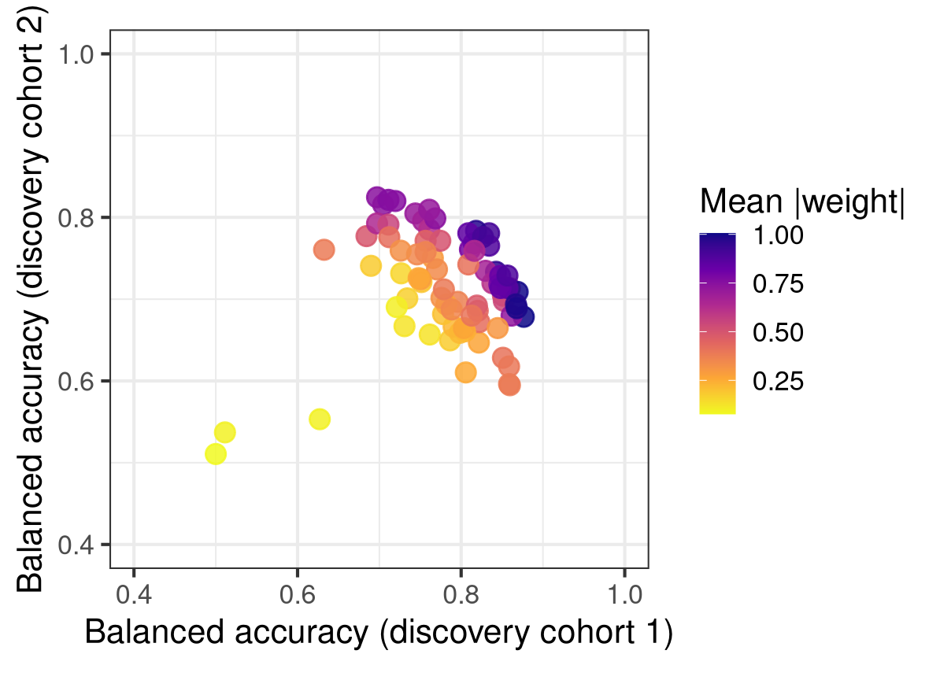
Multi Objective Optimization
We want biomarkers to have certain characteristics related to their use.
A rule out test like ”could this patient potentially have cancer” should have high sensitivity.
A confirmatory diagnosis like ”HIV diagnosis” should have a high specificity.
But what if we wanted to prioritize something abstract like commercialization??

Slide 18

OptiMark
Enumerate all solutions that meet pre-defined clinical criteria (Clinical-Ready Set)
Jointly optimize: predictive power, transferability, stability and translational objectives
Translational objectives: assay cost/time, patent novelty/proxy, operational constraints
Log-ratio modelling + shadow-feature penalties for robustness under shifts

Slide 22
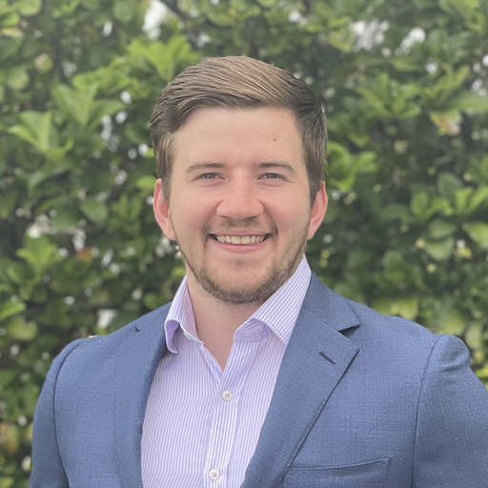
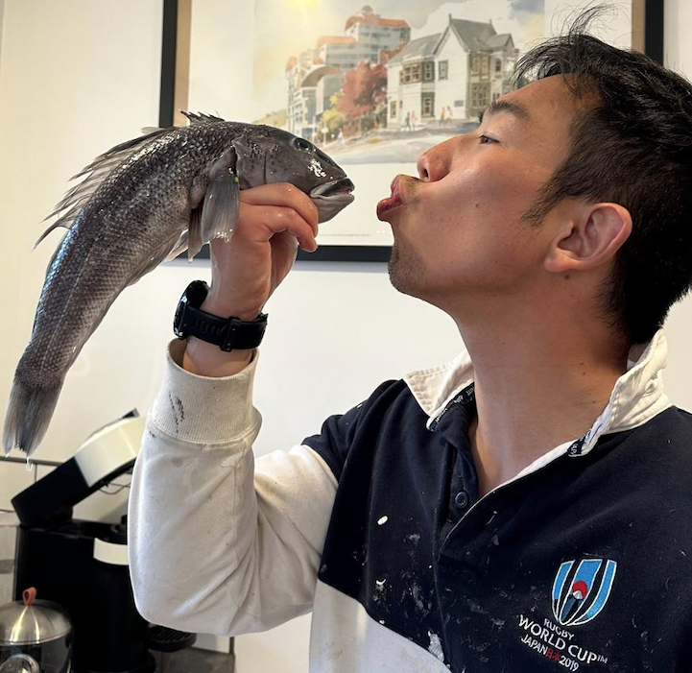
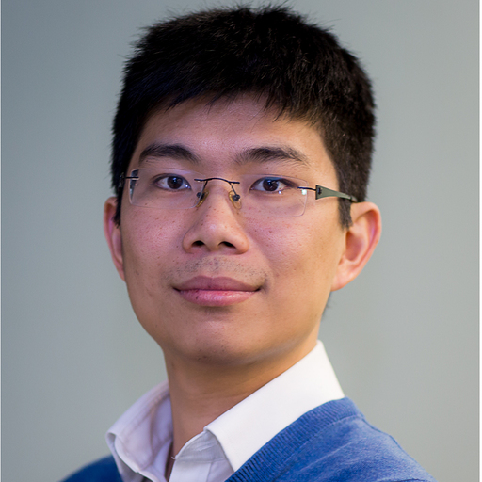
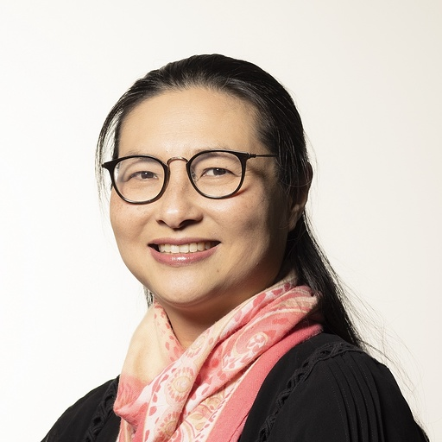
Acknowledgments
Acknowledgments: Sydney Precision Data Science Centre
Our Team
Harry Robertson
Supervisor:
Prof. Jean Yang
Dr. Jie Kang
Dr. Kevin Wang

Slide 23
THANK YOU

